Slide 1

Yelp: User Engagement
Group 7

Slide 2
Concept
Problem:
Where should Yelp focus resources to increase user engagement?
Solution :
Segment total reviews by geography
Business Application:
Geographies with lower engagement present the most headroom for growth. Understanding this can allow Yelp to most effectively allocate resources
Notes:
We define user engagement by quantity of reviews and check-ins

Slide 3
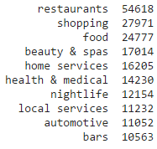
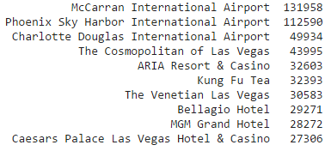
Data Exploration
10 Most Popular Business Categories
10 Most Popular Business Objects
Notes:
Desired results of popular business categories and objects based on the given json data
Based on this information we decided to conduct our analysis on review counts rather than checkins. Checkin data appears to be skewed towards places that users want to broadcast to their friends when they are there: airports and las vegas hotels

Slide 4
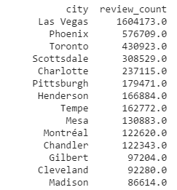
Preliminary Output
Notes:
Here are the cities with the most reviews
This result is not ideal - we cannot accurately conclude that users in Las Vegas are the most engaged because of factors we are not considering.
It is also difficult to understand where these locations are geographically

Slide 5

Preliminary Output Rating
Notes:
This solution is acceptable but can be enhanced
If we were to assign a yelp rating to this solution, we would only give it 3 out of 5 stars because we believe the results are somewhat misleading

Slide 6
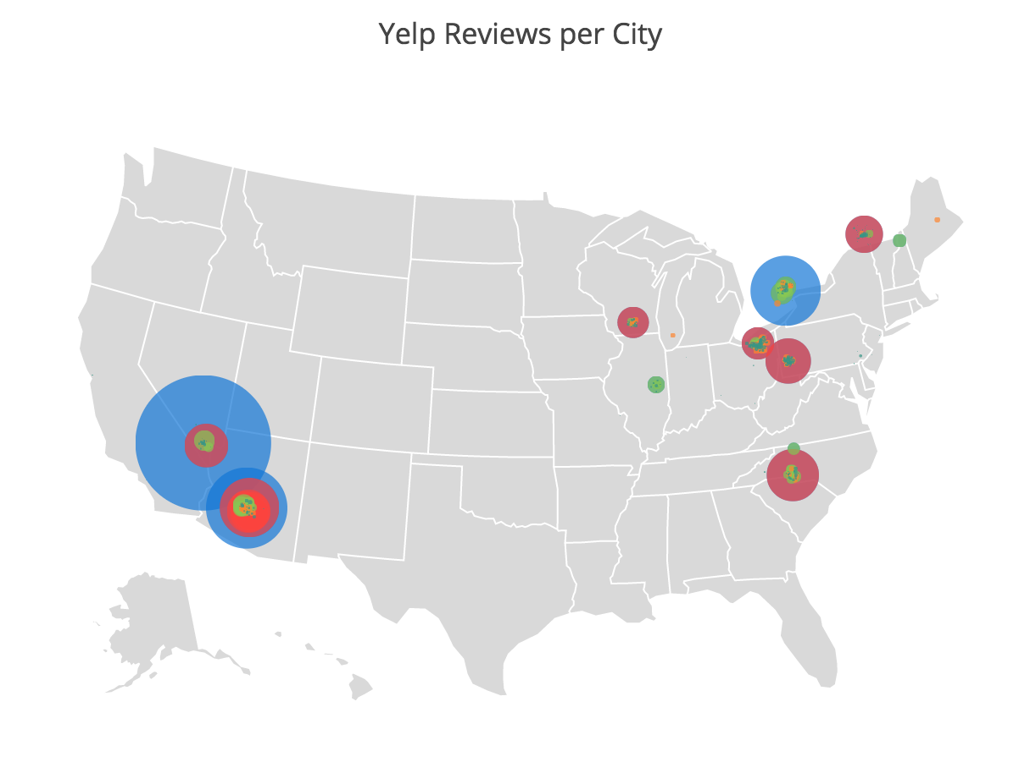
Data Enhancements
Visualize the results geographically
Notes:
This is an improvement over our original table output, as you can clearly see which geographies are being compared
However, this output would indicate that investment is needed in all of the sampled cities besides Las Vegas, Phoenix and Toronto, so another step is needed

Slide 7
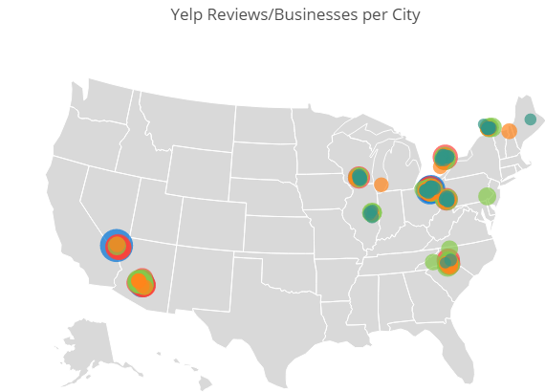
Data Enhancements
Weight results vs business count
Remove noisey results with fewer than 20 businesses
Notes:
Now that the review counts have been weighted by business, the opportunities for increased engagement are more clear
Las Vegas still has the most reviews per business though areas around Cleveland show similar engagement It is apparent that there is opportunity for improved engagement in the orange, dark green and light green bubbles: Champaign/Urbana Illinois, Madison Wisconsin, greater Montreal, and even in Phoenix Arizona

Slide 8

Enhanced Output Rating
Notes:
This solution is much more insightful
Sticking with the Yelp rating system, we are giving this solution 4.5 out of 5 stars
While we believe the solution is useful, there are additional layers of analysis that could improve it even further

Slide 9
Potential Next Steps
City name cleaning / grouping
Business category segmentation
Impact of ‘elite’ users
Local reviewers vs tourist reviewers
Notes:
City Name appears to be a free-form text field which is subject to typos, so additional data cleaning and grouping could further improve our analysis
Segment analysis by business category and examine any contradictory trends
Quantify the impact of super users who post a high volume of reviews. Is the presence of these users critical to achieving increased overall engagement?
Segmenting the dataset by “locals” and “tourists” would allow Yelp to better understand what opportunity exists in a certain geography. Popular tourist destinations will have inflated review counts when compared to locations where most of the reviews are from locals

Slide 10

Questions?

